Slide 1
Who will leave in the next 30 days?
MACHINE LEARNING AND DEEP LEARNING · EXAM CASE
Churn prediction for a subscription business
Mine Demir · 22 October 2026
Notes:
Hi, my name is [name], and I’ll present my churn prediction project. (Then go straight to the next slide.)

Slide 2
The goal: a ranked list of customers at risk
1 · THE PROBLEM
PREDICT
ONE ROW
DECISION
Will this customer cancel within 30 days?
One customer on one date
Whom to contact first?
Snapshot 2026-08-01; only data known that day may be used
The retention team has limited capacity, so ranking matters most
Yes or no: binary classification
Notes:
A subscription company wants to know which customers are about to leave, so it can act before they go. My task was to predict, for each customer, whether they will cancel within the next 30 days. One row is one customer on one date: the snapshot, 1 August 2026. The target is yes or no, so this is binary classification. The customer-success team can’t call everyone, so what they really need is a ranked list: who should we contact first? That idea, ranking under limited capacity, shaped the rest of my work. (~1 min)

Slide 3
1,800 customers, and only 18% churn
2 · THE DATA
PROBLEMS FOUND AND FIXED
18%
18 exact duplicates
Removed before the split, so no customer is in both train and test
churn: always guessing “stays” scores 82% accuracy and finds no one
79 impossible rows
0 login days but 18-minute sessions: session time set to missing
NPS with decimals
Probably an average, so interpreted with care
Notes:
The dataset has about 1,800 customers and 20 columns. Only 18% churn, so the classes are imbalanced. Accuracy is misleading: a model that always says ‘stays’ gets 82% and finds nobody. Before modelling I found three problems: 18 exact duplicates, removed before splitting so no customer ends up in both training and test; 79 customers with zero logins but an 18-minute average session, which is impossible, so I set session time to missing for them; and NPS with decimals, which suggests an average, so I interpret it with care. (~1 min)

Slide 4
A higher score can be a fake score
3 · LEAKAGE
days_until_churn
ROC-AUC, LOGISTIC REGRESSION
Only filled in for customers who already left. It gives away the answer, so it was dropped.
0.86
with the offer: fake
retention_offer_sent
0.75
65% churn with an offer vs 8% without. Offers are a reaction to known churn, and they are the decision the model should support. Excluded.
without: honest
I chose the lower, honest score.
Notes:
The most important finding was data leakage: information the model would not have on the day it predicts. My rule: only use what is known on the snapshot date. days_until_churn only has a value for customers who already left, so it gives away the answer; I dropped it. retention_offer_sent was harder to see: 65% churn with an offer vs 8% without. Offers are sent after the company already sees a customer leaving, and it is the decision my model should support. Adding this one column raised ROC-AUC from 0.75 to 0.86, but that score would not hold in production. So I deliberately chose the lower, honest score. (~1.5 min, slow down here)

Slide 5
A fair, leak-proof setup
4 · METHOD
1
2
3
4
Split 80 / 20
Pipeline
5-fold CV
Two baselines
Stratified. The test set is locked away and used once, at the end.
Imputing, scaling and encoding learn from training data only.
The same folds for every model, so the comparison is fair.
Always “stays”, and a business rule: monthly contract + few logins.
Notes:
I split the data 80/20, stratified so both parts have the same churn rate. The test set was locked away and used only once, at the very end. All preprocessing (filling in missing values, scaling, encoding categories) sits inside a scikit-learn pipeline with the model, so it only learns from training data, which prevents leakage. I compared models with 5-fold cross-validation, the same folds for every model. And I built two baselines: always ‘stays’, and a simple business rule. A model is only worth it if it beats what a manager could do by hand. (~1 min)

Slide 6
The simplest model wins; complex ones overfit
5 · MODEL COMPARISON
Model (5-fold CV) | ROC-AUC | PR-AUC | Train ROC-AUC | Overfit gap
Logistic Regression (best) | 0.753 | 0.429 | 0.797 | 0.04 (small)
Random Forest | 0.747 | 0.409 | 0.992 | 0.25 (large)
Gradient Boosting | 0.720 | 0.372 | 0.952 | 0.23 (large)
Business rule (baseline) | 0.618 | 0.255 | – | –
Tuning (grid search) did not change the ranking: the data is small and the patterns are simple.
Age removed: ROC-AUC 0.753 → 0.752. Same performance, no age-based targeting.
Notes:
I compared Logistic Regression, Random Forest and Gradient Boosting. All three clearly beat the business rule: about 0.75 against 0.62. The interesting part is which model won: the simplest one. Point to the train column: the tree models score 0.99 on training data but only 0.75 on new data. That’s overfitting: they memorise the training customers. Logistic Regression’s gap is only 0.04. Tuning the trees with a grid search didn’t change the ranking; Gradient Boosting even chose its least flexible settings. Finally, I removed age: performance didn’t change, and using age to decide who gets offers raises fairness concerns. (~1.5 min)

Slide 7
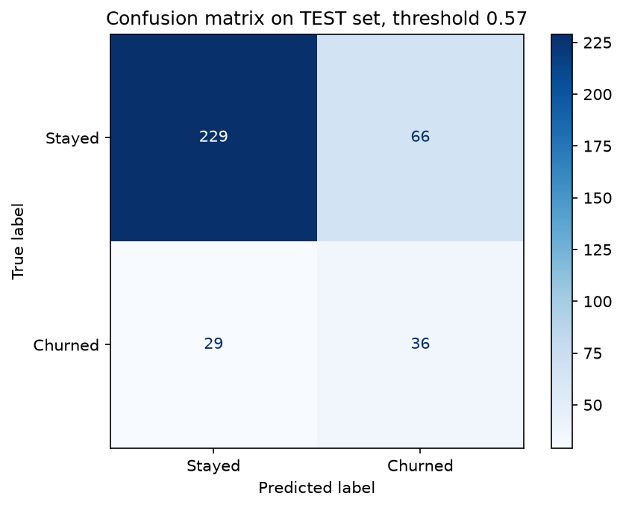
Test ROC-AUC 0.76: 2.1× better than random
6 · RESULTS AND ERRORS
55%
of churners found (36 of 65) at threshold 0.57
2.1×
more churners in the top 20% than random
Missed churners look loyal
14 login days a month, vs 8 for churners found. The fix is new data, not a bigger model.
Notes:
On the test set the final model reached ROC-AUC 0.76, the same as in cross-validation, so the estimate was reliable. I set the threshold at 0.57, leaning towards recall, because missing a customer who leaves usually costs more than an unnecessary call. The model then finds 55% of churners. In business terms: if the team calls the riskiest 20%, they reach churners 2.1 times more often than at random. Then the mistakes: the customers the model misses look loyal, logging in 14 days a month, while the churners it finds log in about 8. These silent churners leave for reasons not in the data, so the fix is new data, like when their contract is up for renewal. (~1.5 min)

Slide 8
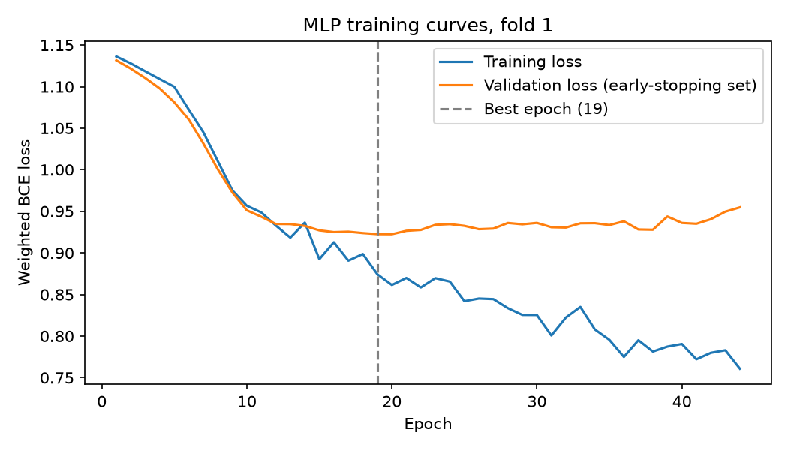
Deep Learning: tested, no gain
7 · DEEP LEARNING AND TRANSFER LEARNING
PyTorch network
31 → 32 → 16 → 1, ReLU, dropout, Adam, early stopping
Same as Logistic Regression
ROC-AUC 0.749 vs 0.752; won 2 of 5 folds. Overfits after ~15 epochs.
Transfer Learning: not relevant
Our columns are company-specific. It would fit support-ticket text with a pretrained language model.
Notes:
I also built a neural network in PyTorch: two hidden layers, dropout and early stopping. On the same folds it scored 0.749 against 0.752 for Logistic Regression; it won two folds and lost three, so no real difference. The training curves show it starting to overfit after about 15 epochs. With about 1,400 rows of table data, Deep Learning’s strengths aren’t used, and with equal performance I choose the simpler model. It would make sense with much more data, with sequences like daily logins, or with support-ticket text. Transfer learning means reusing a model trained on huge amounts of data like images or text. Our columns are specific to this company, so there’s nothing general to transfer; it would become relevant with support-ticket text and a pretrained Swedish language model. (~1 min)

Slide 9
Logistic Regression as a monthly risk ranking
8 · RECOMMENDATION
Why
Limits
Next
As good as or better than complex models
Least overfitting, stable
Shows why a customer is flagged
One snapshot in time
Small data: ~320 churners
Weaker on long contracts
Test on a later snapshot
Add months until renewal
A/B test retention offers
IN PRODUCTION
Pipeline saved with input schema and versions · validate new data · monitor drift and recall (true labels arrive 30 days late) · retrain on drift or quarterly
Notes:
My recommendation is Logistic Regression, used as a monthly risk ranking for the retention team. It’s as good as or better than the complex models, it overfits least, it’s stable, and the team can see why a customer is flagged. The main limitations: only one snapshot in time, a fairly small dataset, and it’s weaker for customers on long contracts. I saved the full pipeline with its input schema and library versions, plus a function that validates new data. In production I’d monitor data drift and recall, keeping in mind that the true answers arrive 30 days late, and retrain when things change. Next steps: test on a later snapshot, add a months-until-renewal feature, and run an A/B test to see which customers an offer can actually save. (~1 min)

Slide 10
Thank you. Questions?
An honest 0.75 that holds up in practice beats a 0.86 that doesn’t.
Notes:
Thank you. I’m happy to take questions.

